Slide 1
2024 Annual shareholder’s meeting
April 9, 2024

Slide 2
outreach
Website

Slide 3
outreach
- eNews

Slide 4
outreach
e-mail
telephone

Slide 5
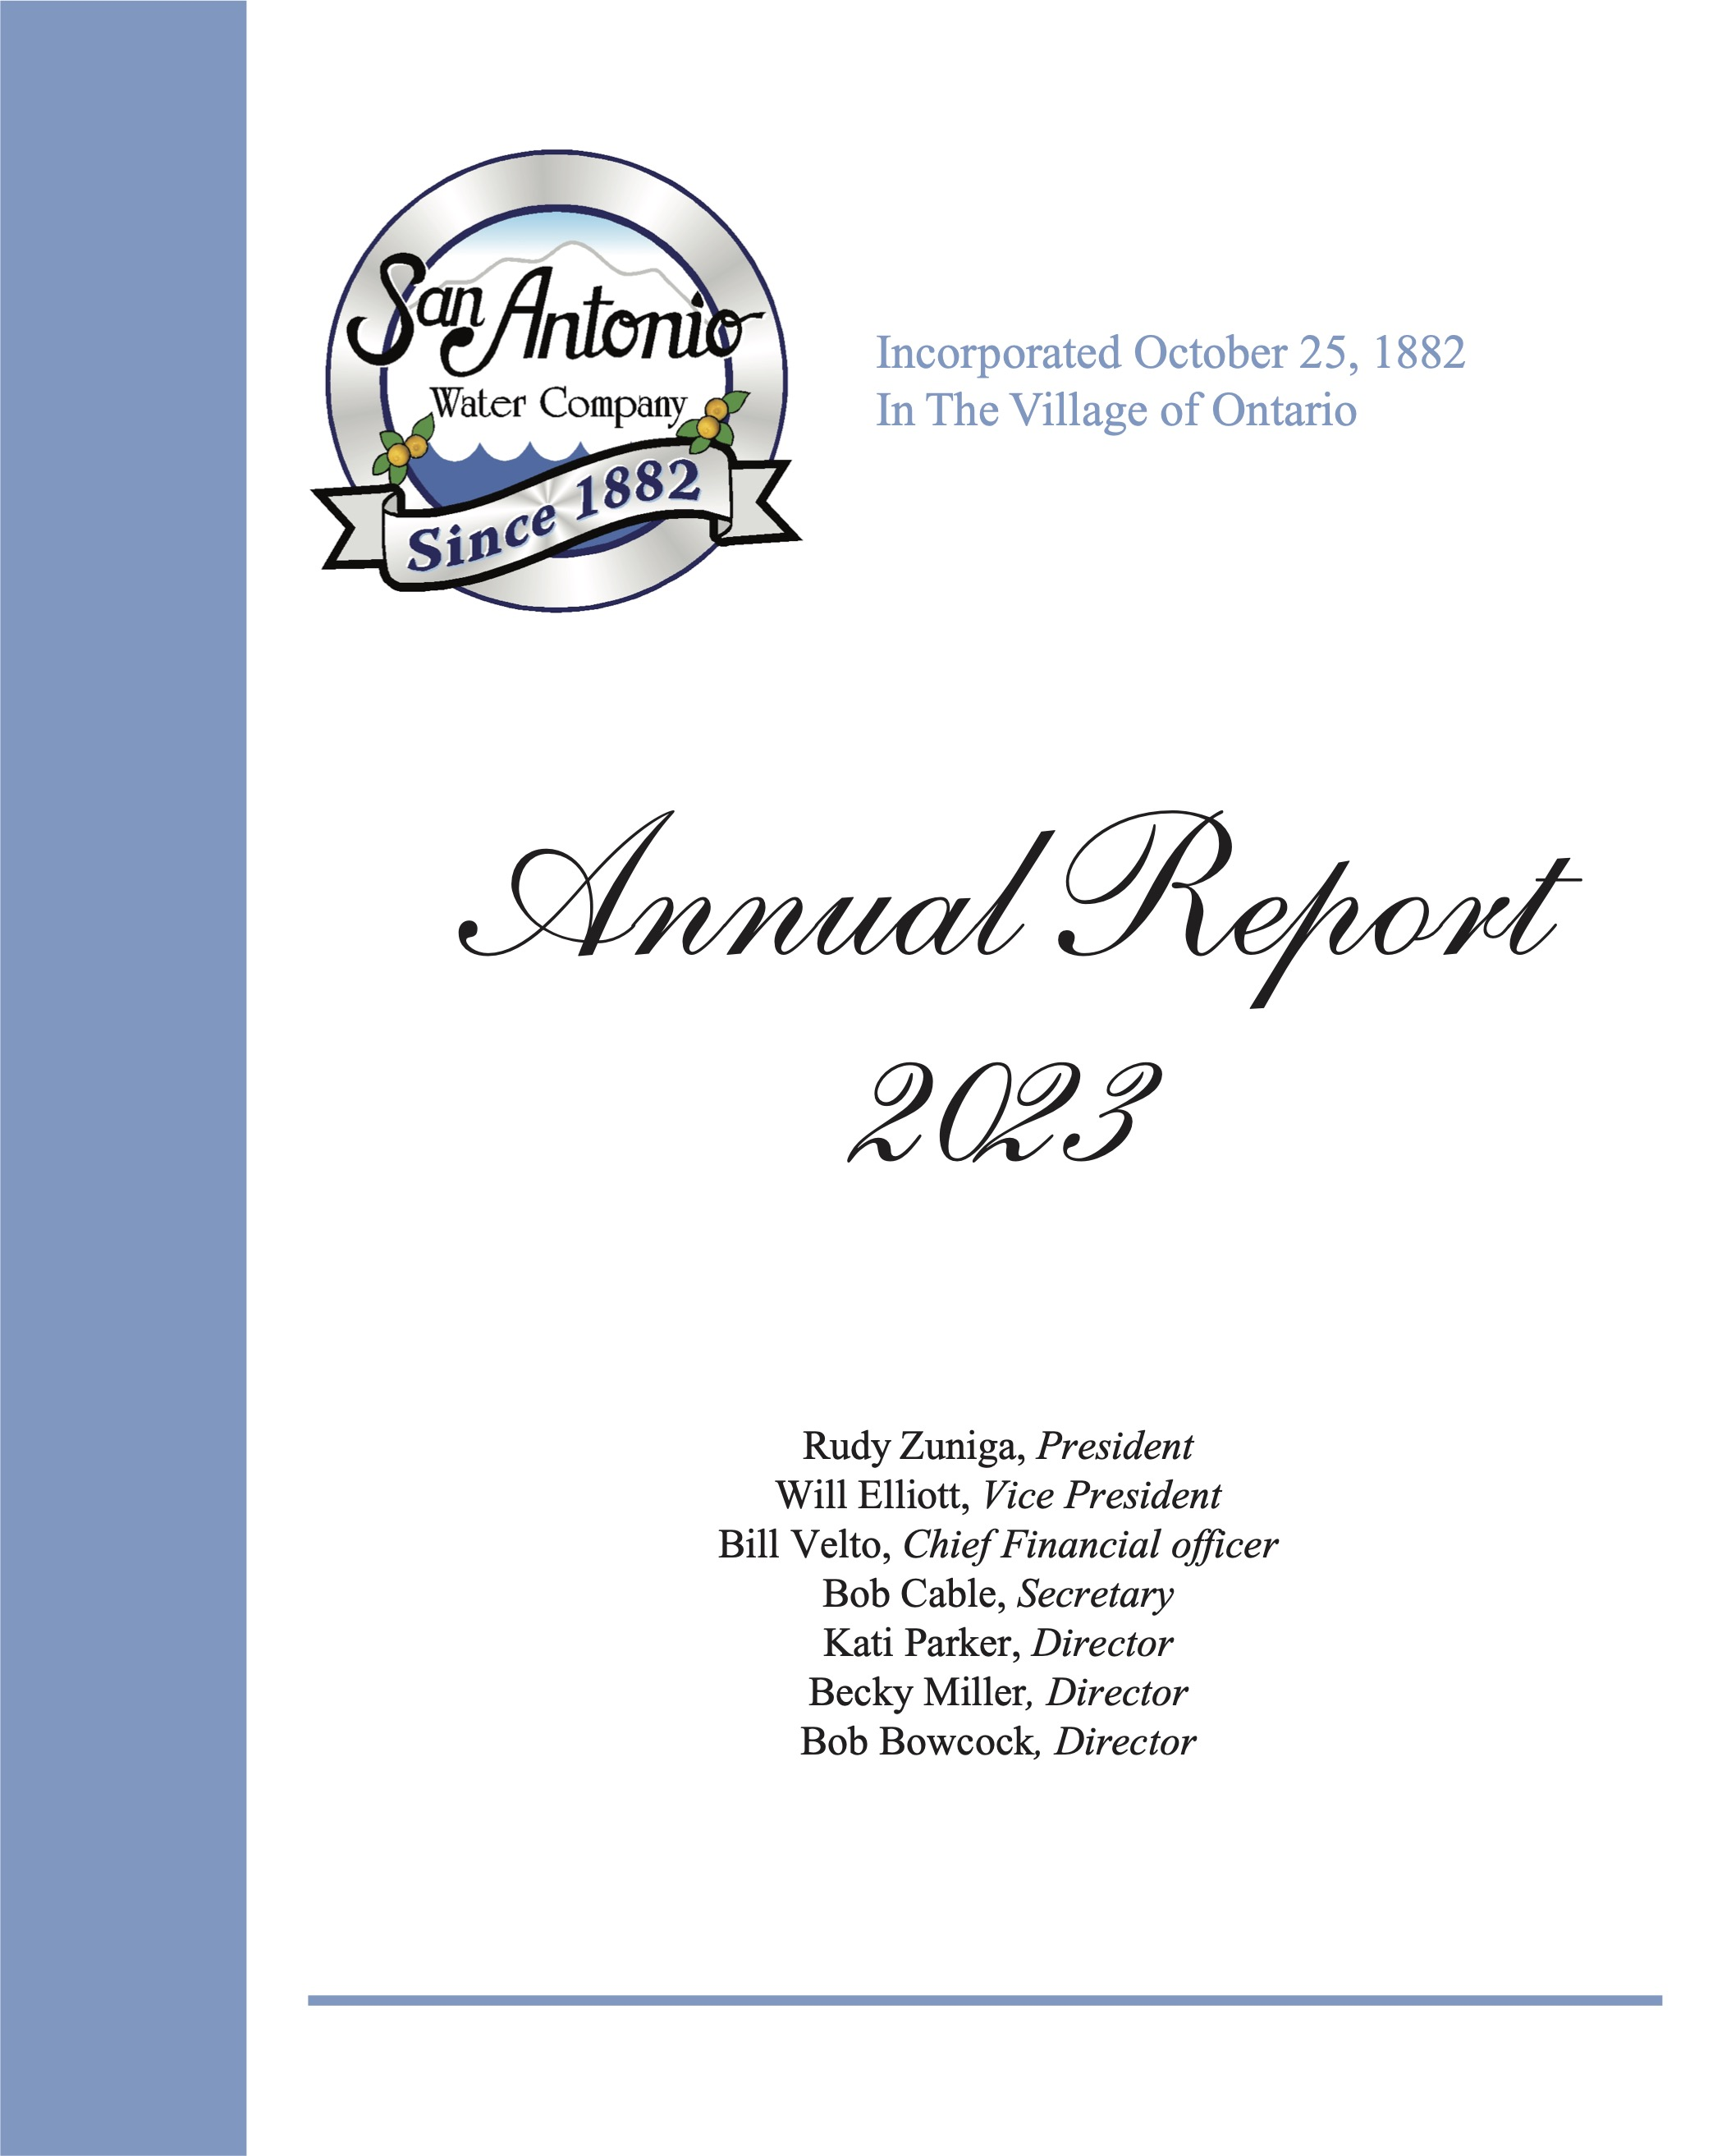
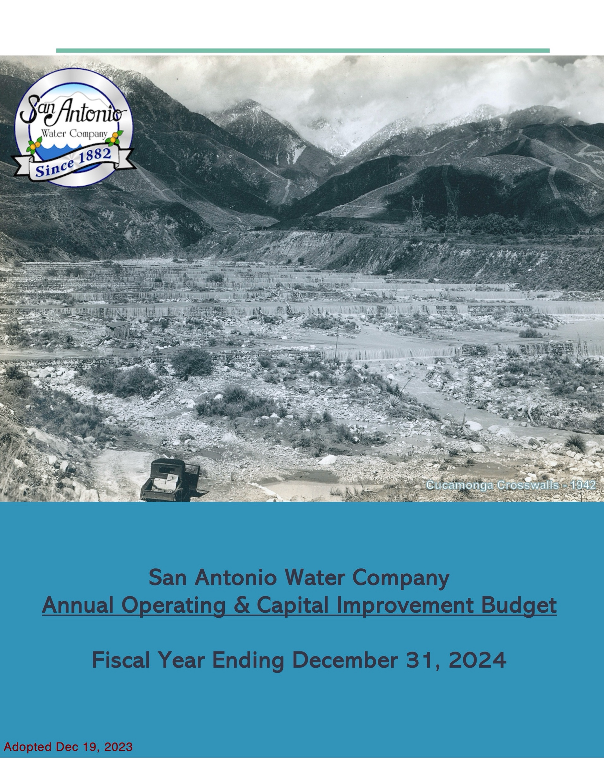
Available Information

Slide 6
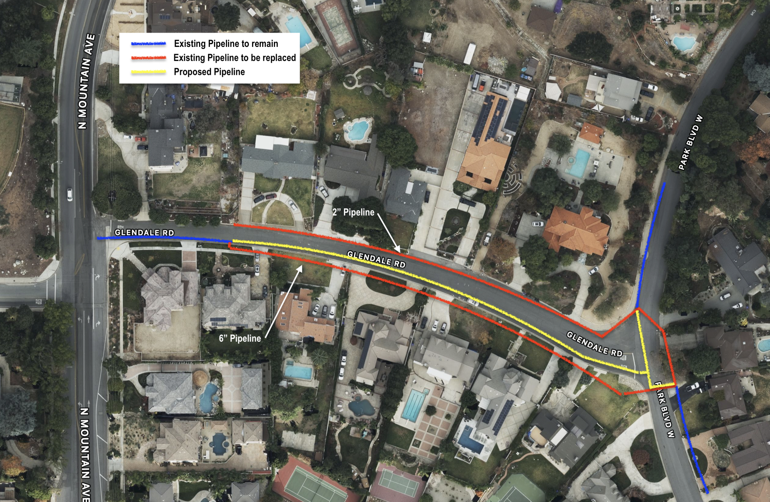
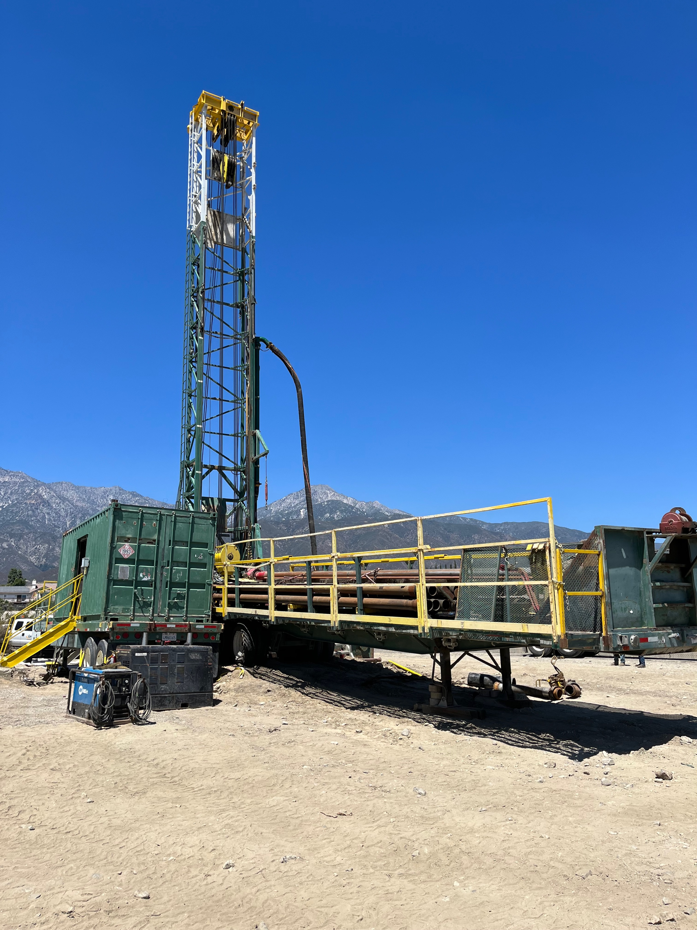
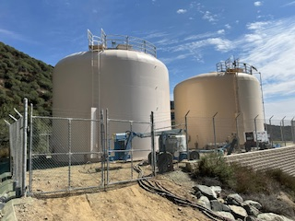
PROJECTS- 2023
Glendale Road Pipeline Replacement
Well 19 – 1,500 gpm
Holly Drive Reservoir 120,000 Gallons Total Storage
Notes:
Understatement of the year… enough rainfall
We remain a well governed company, financial healthy with a bright future.

Slide 7
140 years in business The San Antonio water company remains a well governed company, financially healthy with a bright future

Slide 8
2024 Annual shareholder’s meeting
Thank You!
April 9, 2024

Slide 9
Please reach out with any questions or concerns
blee@sawaterco.com
909.982.4107
Notes:
We remain a well governed company, financial healthy with a bright future.

